Slide 1
Welcome to the presentation “Phonics Short ‘a’ Vowel Sounds!
To view this as a slide show , on the View tab, in the
Presentation Views group, click Slide Show .
© WAG. All rights reserved
Phonics Short ‘a’ Vowel Sounds

Slide 2
© WAG. All rights reserved
“ab” Words

Slide 3

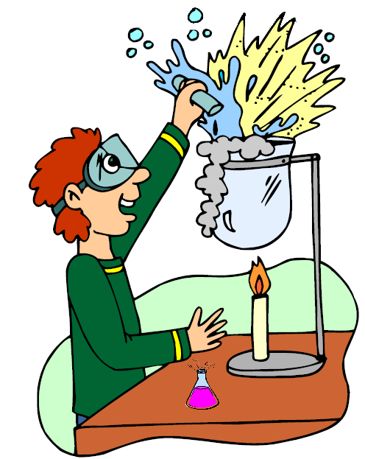
© WAG. All rights reserved
cab
lab

Slide 4
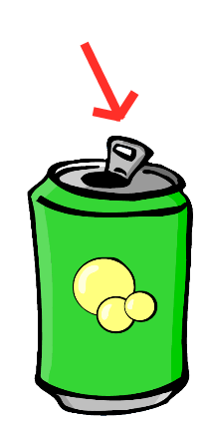
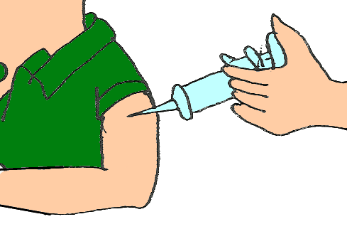
© WAG. All rights reserved
tab
jab

Slide 5
© WAG. All rights reserved
“ad” Words

Slide 6
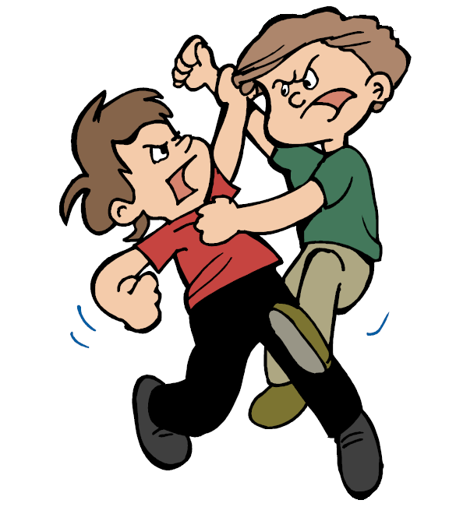
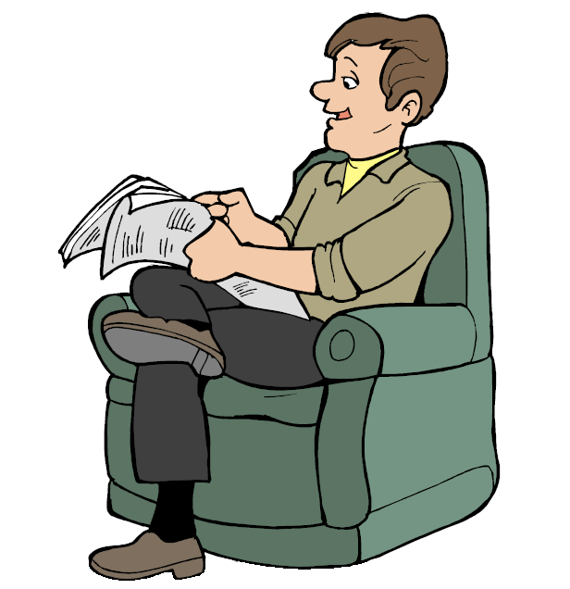
© WAG. All rights reserved
bad
dad

Slide 7
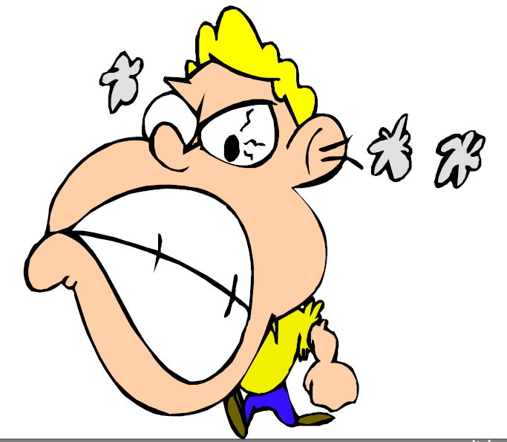
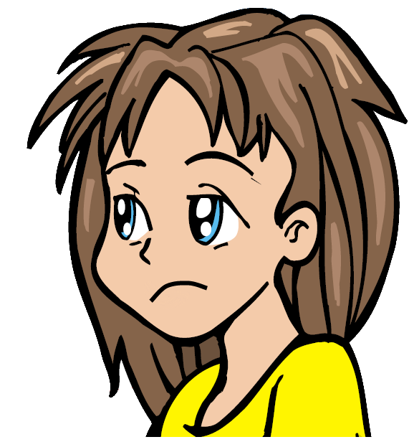
© WAG. All rights reserved
mad
sad

Slide 8
© WAG. All rights reserved
“ag” Words

Slide 9

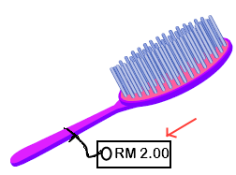
© WAG. All rights reserved
bag
tag

Slide 10
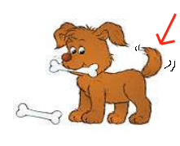
© WAG. All rights reserved
wag

Slide 11
© WAG. All rights reserved
“am” Words

Slide 12
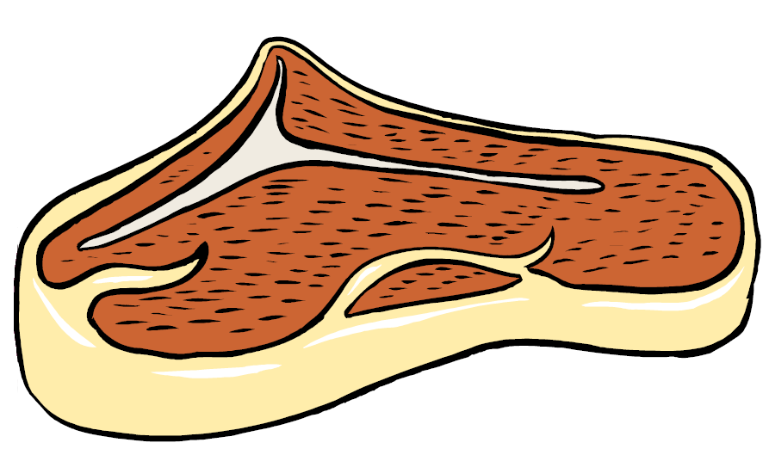
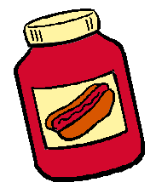
© WAG. All rights reserved
ham
jam

Slide 13

© WAG. All rights reserved
pam

Slide 14
© WAG. All rights reserved
“an” Words

Slide 15

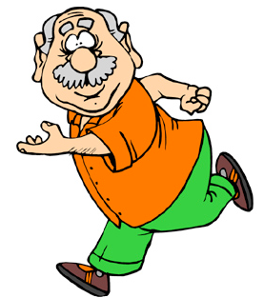
© WAG. All rights reserved
can
man

Slide 16

© WAG. All rights reserved
pan
ran

Slide 17


© WAG. All rights reserved
fan
tan

Slide 18
© WAG. All rights reserved
“ap” Words

Slide 19

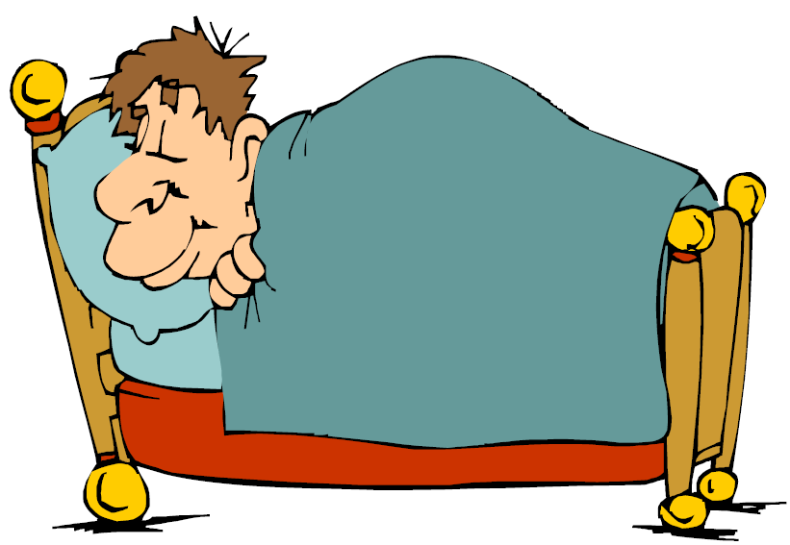
© WAG. All rights reserved
cap
nap

Slide 20
© WAG. All rights reserved
“at” Words

Slide 21


© WAG. All rights reserved
bat
cat

Slide 22


© WAG. All rights reserved
mat
hat

Slide 23
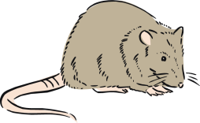
© WAG. All rights reserved
rat

Slide 24
© WAG. All rights reserved
Thank you for downloading and viewing WAG’s “Phonics Short ‘a’ vowel sounds” presentation from
www.wagenglishzone.weebly.com
Please visit this site again.
Go back to the first slide
End the show

